Slide 1

Project Intake Process
Joseph Castle
5/3/16

Slide 2
Purpose
This presentation explains how the GSA Digital Services (DS) team realizes and accepts new projects. Furthermore, it identifies partnering of GSA DS and requesters to collaborate and implement new technology solutions.

Slide 3
General Considerations
Resources from Requester
Budget availability and source(s)
People (end users, product owner, executive sponsor, business/IT members)
Skills Provided by GSA DS
Agile (Scrum, Kanban) - PM, coaching, team integrations, pilots/prototypes, investment
Design - UX (personas, wireframes), UI, graphic, information architecture
Development - front-end web and mobile, back-end (transactional) w/ pure code (Java, Python)
Data Management - Open Data, APIs, architecture
Types of projects - modernization through Agile with skills provided by GSA DS
LoE Considerations by All Parties
Scope and assess hours to implement; utilize technical sprints and Agile investment process; consider when pilot is completed and hand-off is conducted
Determine projects underway and in pipeline

Slide 4
Request Intake Process
Path 1: Via the Solutions Strategy Agile Investment Process
Came EBC or SS process
Should come with researched solution for consideration for implementation
Highest priority as identified through GSA governance
Path 2: Via Direct Request
Direct request by an individual or an organization, still needs to go through Agile Investment process
Needs to be scoped, possibly through Solutions Strategy
Moderately high priority depending on GSA governance
Path 3: Public Data/Design Event
Utilize MVP development through a public event (Hackathon, Code-Along, Design Challenge, etc.)
Needs to be scoped, consider Agile Investment process
Lowest priority based on GSA governance

Slide 5
Roadmap
Path 1: Solutions Strategy Agile Investment Request
Requester works with ACIO in identify need and resource(s)
SS conducts analysis of proposed need and potential resources
GSA DS assists business sponsor through Agile investment process, determine team members, scope iterations
Combined team walks through Scrum session(s) to deliver pilot, complete pilot and hand-off to ACIO
Path 2: GSA DS Direct Request
Requester identifies a technical need and contacts GSA DS
Requester determines resources; identifies team (end users, product owner, executive sponsor, etc.)
GSA DS assists business sponsor through Agile investment process, scope iterations
Combined team walks through Scrum session(s) to deliver pilot, complete pilot and hand-off to ACIO
Path 3: Public Data/Design Event Request
Business sponsor defines project for event; participant develops MVP during event
Business sponsor decides to take to pilot and determines resources
Business sponsor and GSA DS consider team (end users, product owner, executive sponsor, etc.)
GSA DS assists business sponsor through Agile investment process, scope iterations
Combined team walks through Scrum session(s) to deliver pilot, complete pilot and hand-off to ACIO

Slide 6
Backup Slides

Slide 7
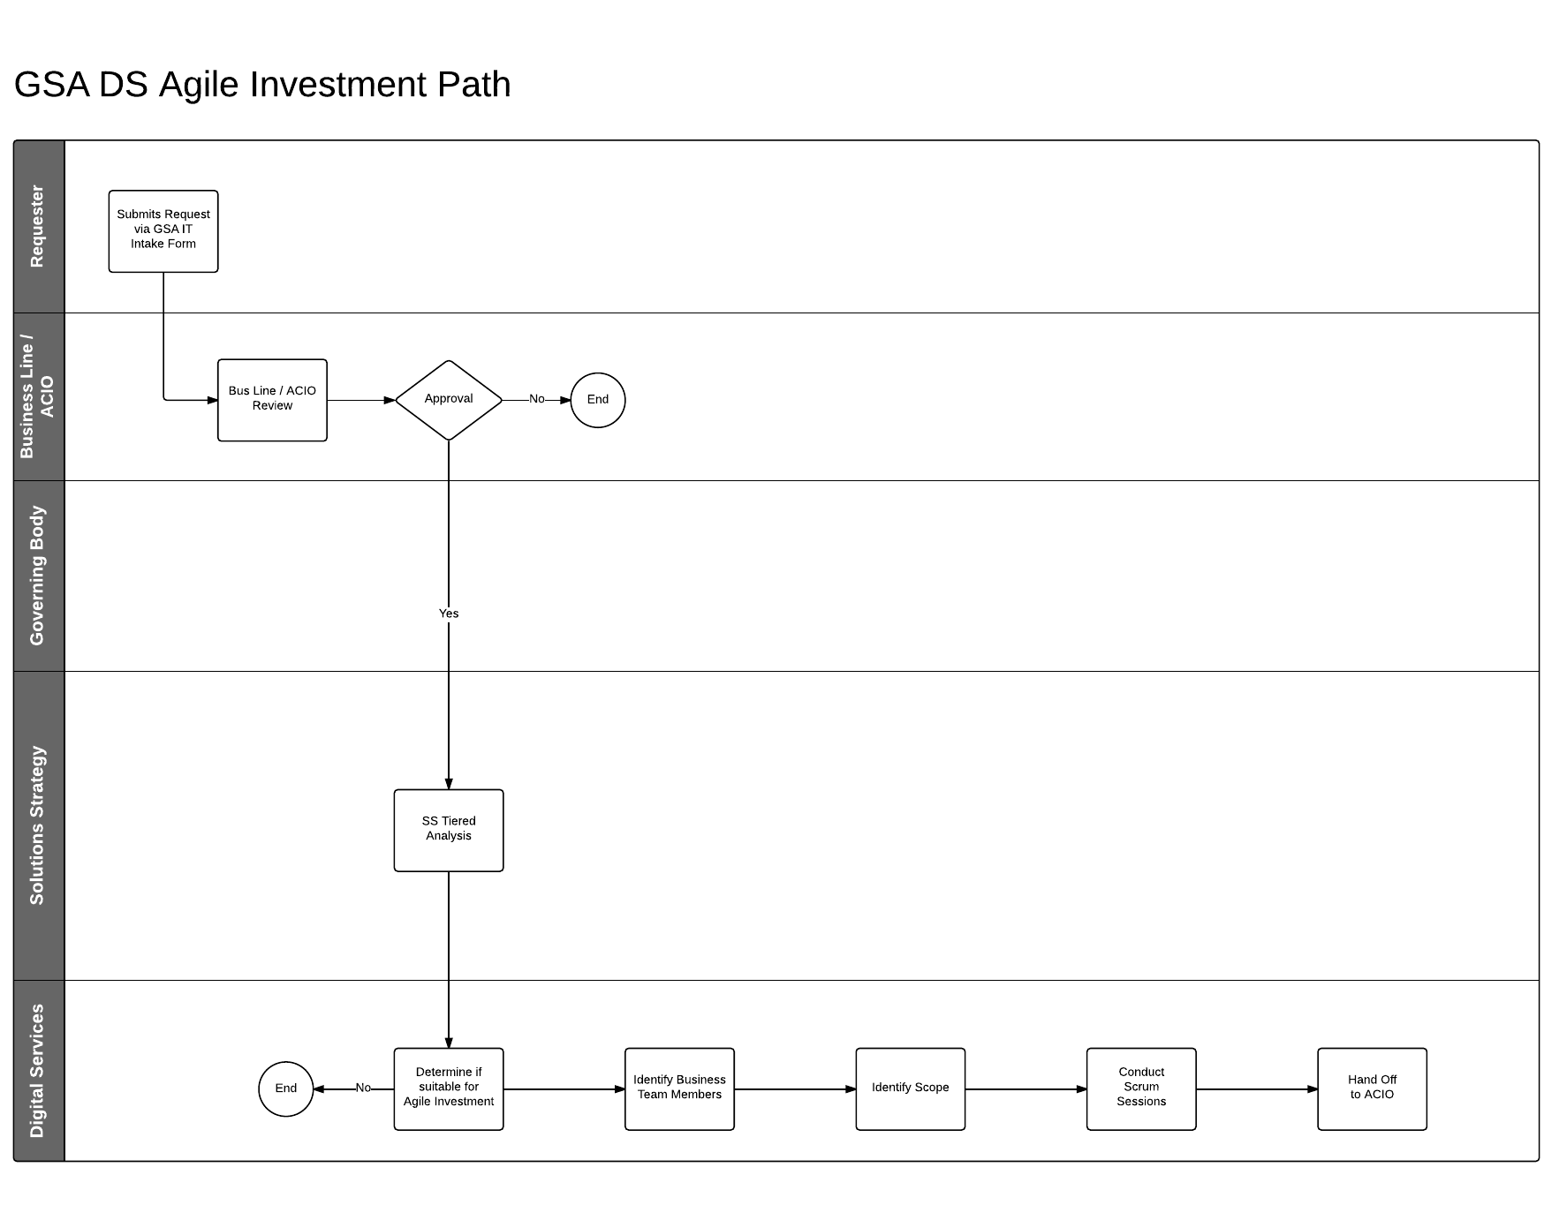
SS Agile Investment Request Path

Slide 8
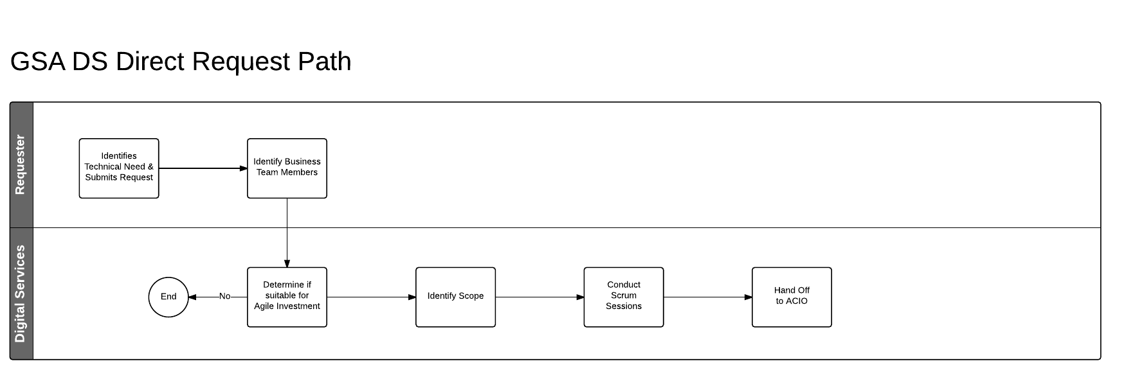
GSA DS Direct Request Path

Slide 9
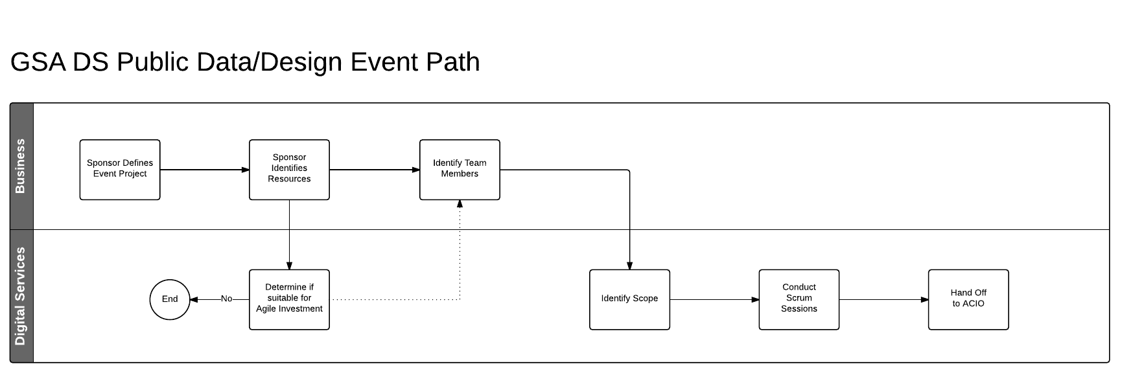
Public Data/Design Event Request Path

